Slide 1

SHRI VISHNU ENGINEERING COLLEGE FOR WOMEN (Autonomous) RADAR SYSTEM USING ARDUINO AND ULTRASONIC SENSOR
Team Members:
20B01A05D5-P. Raga Vallika
20B01A05F1-S.Sadhana
20B01A05G1-Sk.Lohinaz
20B01A05H6-V.Kalyani
21B05A0514-Sk.Asma
Guide by:
Mr. Surendhra Kumar

Slide 2
Introduction:
RADAR is a object-detection system
Transmitter producing electromagnetic waves
It Uses radio waves to determine the range, angle or velocity of objects
Used to detect aircraft, ships, spacecraft ,guided missiles, motor vehicles, weather formations and terrain

Slide 3
Abstract:
To detect the any object in its defined range and give a visual representation of detected object .with respect to these we are also providing angle or position of the object and distance of the object The major component of these system are ultrasonic-sensor , servo motor and the Arduino
Hardware Components:
Servo motor, Ultrasonic sensor, Arduino UNO
Software Components:
Arduino IDE , Processing IDE

Slide 4
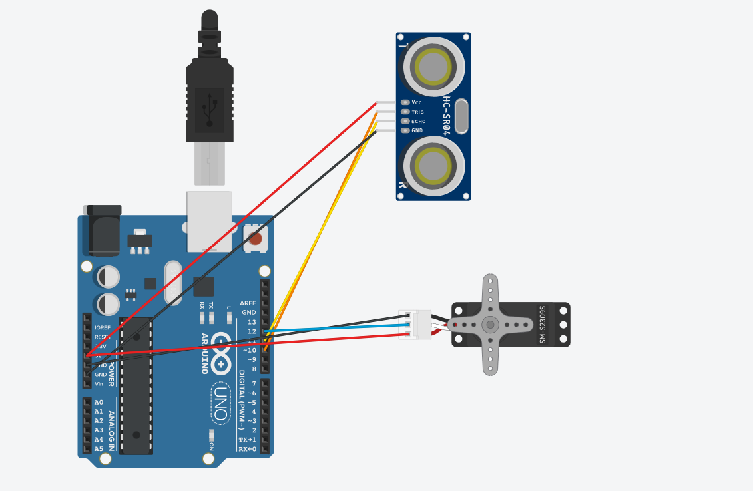
Circuit

Slide 5
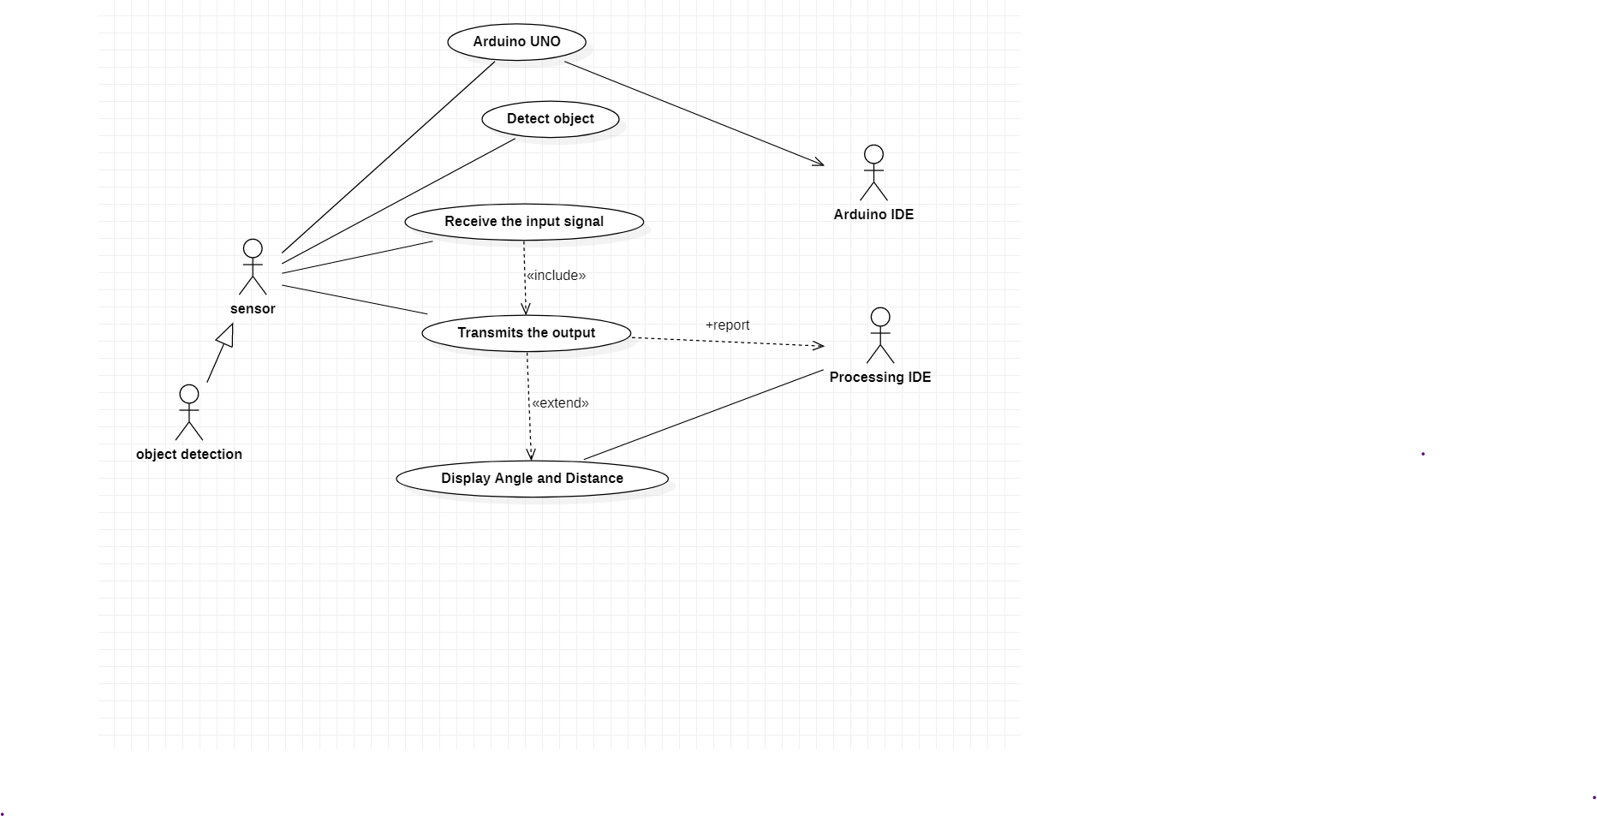
Design: Usecase diagram

Slide 6
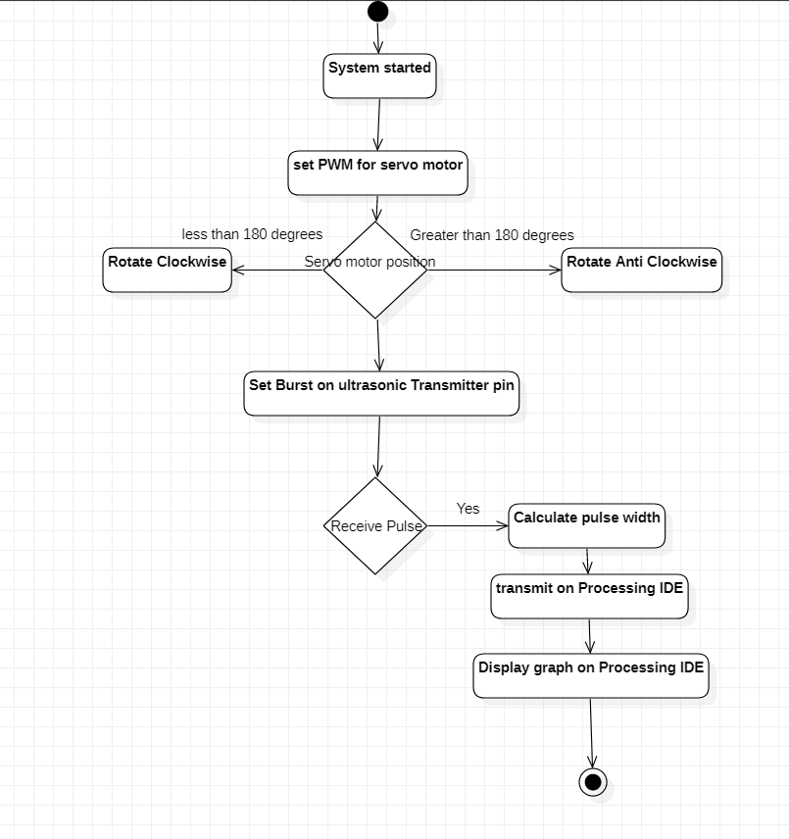
Activity diagram

Slide 7
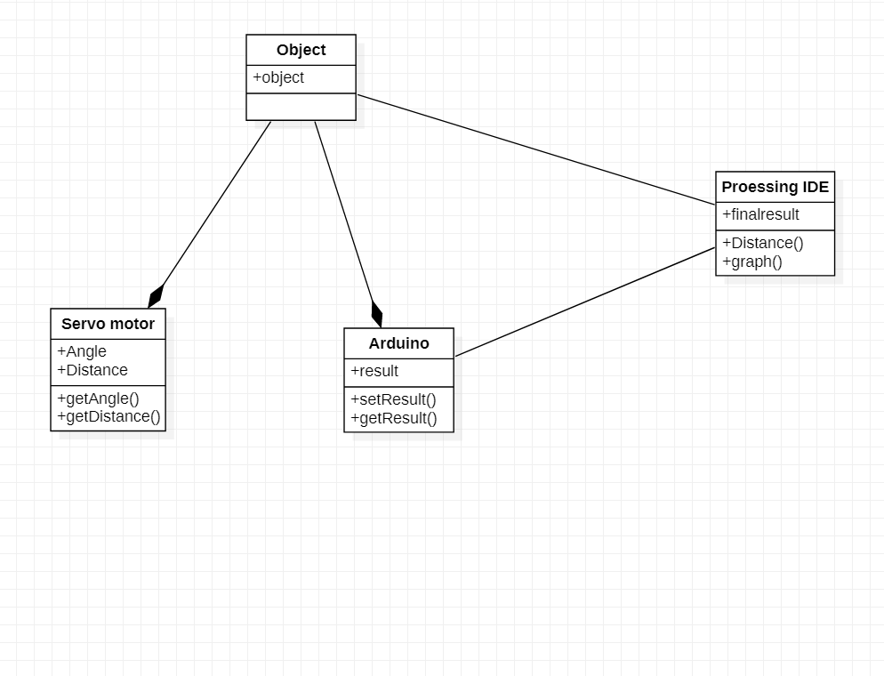
Class diagram

Slide 8
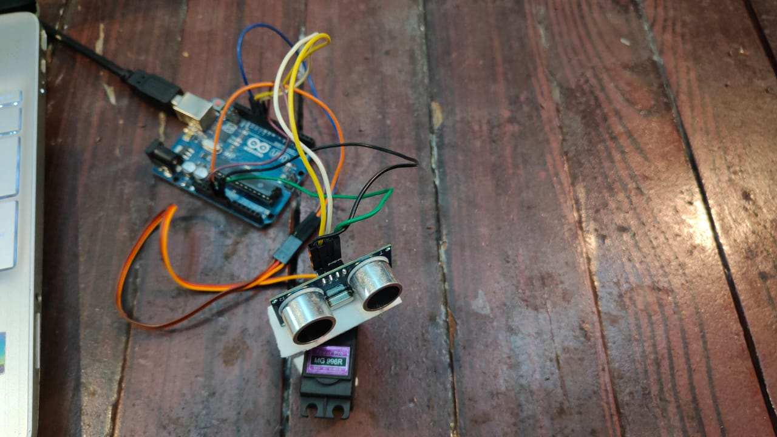
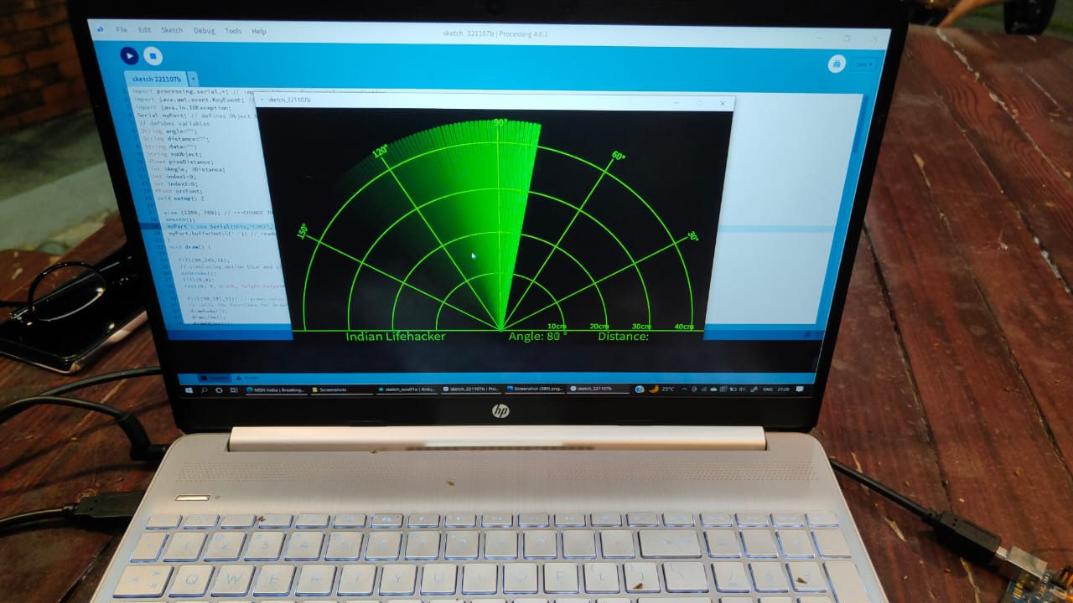
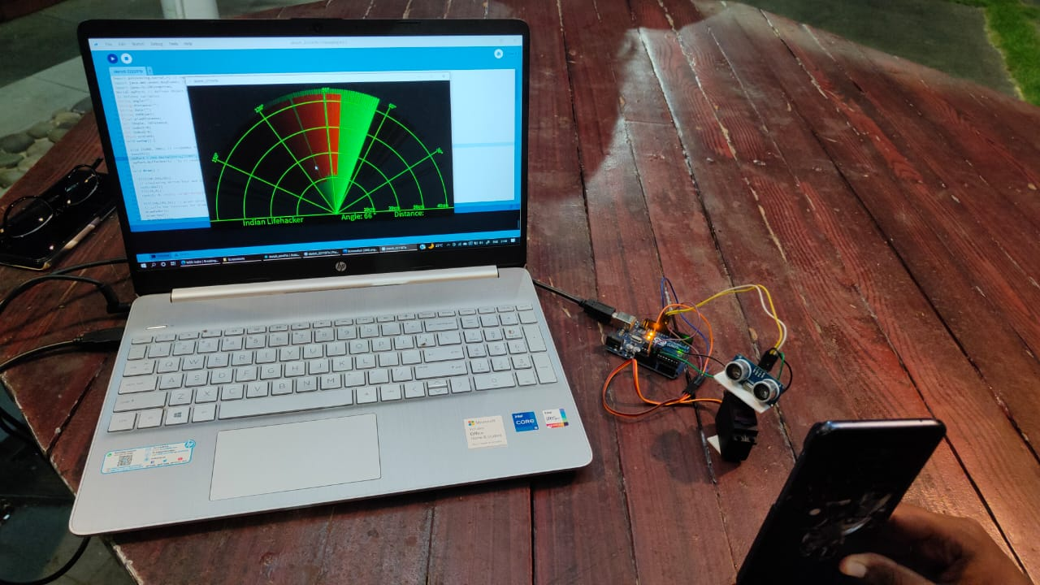
Implementation:

Slide 9
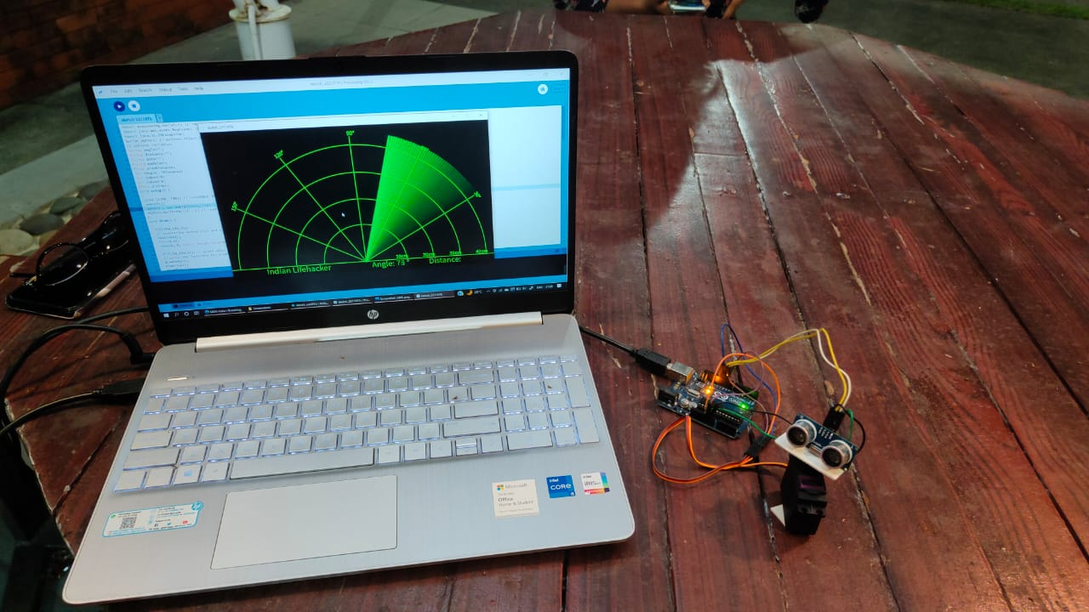
Testcases
When there is no object placed Infront of the sensor

Slide 10
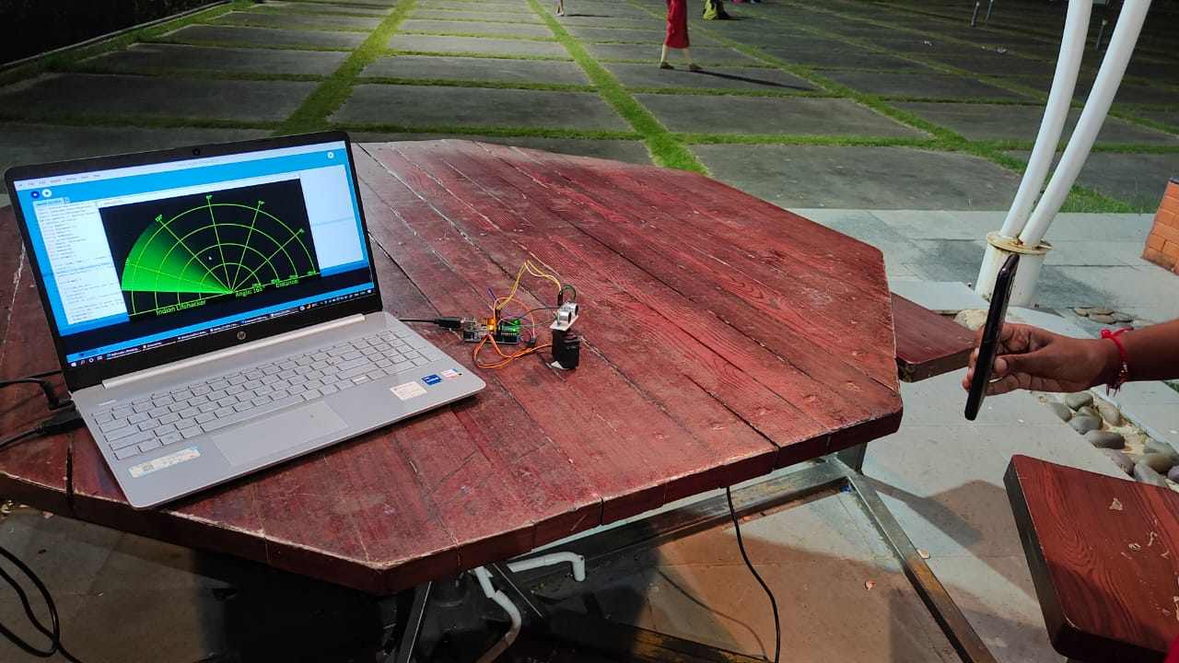
Distance exceeds the range of radar range

Slide 11
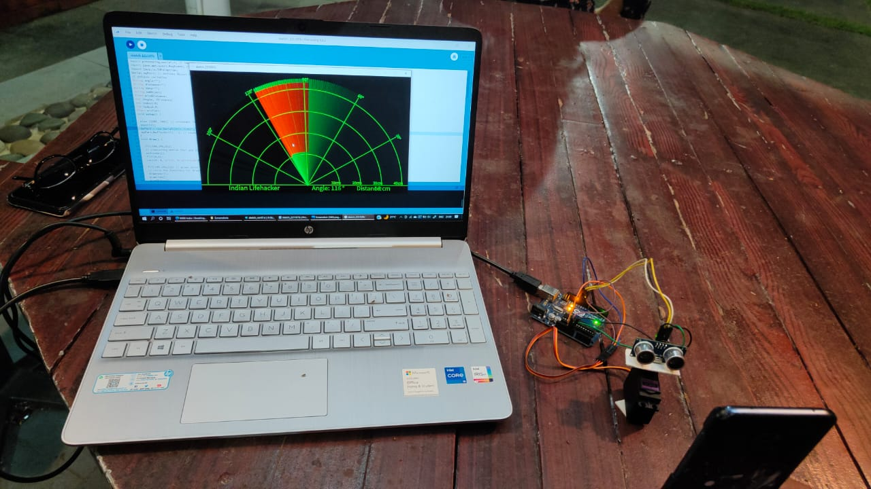
Sensor detects the objects at different distance

Slide 12
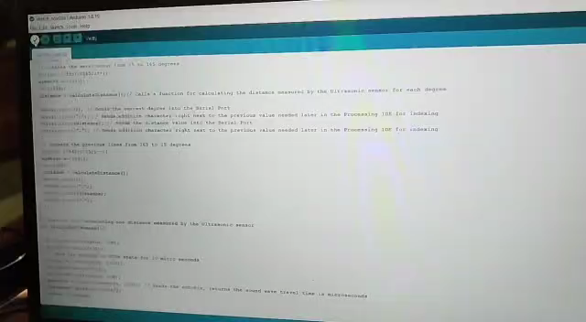
Execution Video:

Slide 13


